Slide 1




Slide 2
DATABASE MANAGEMENT SYSTEM
By:
Harika Devineni
Employee id:46131865
Batch: JEE with Cloud AWS-API
Development Batch 2

Slide 3
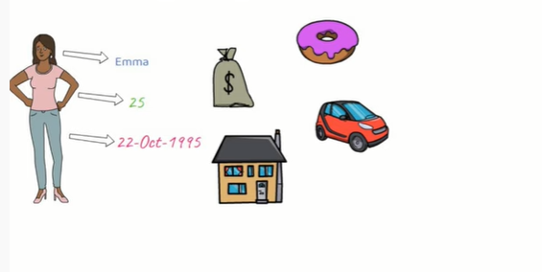

Data

Slide 4

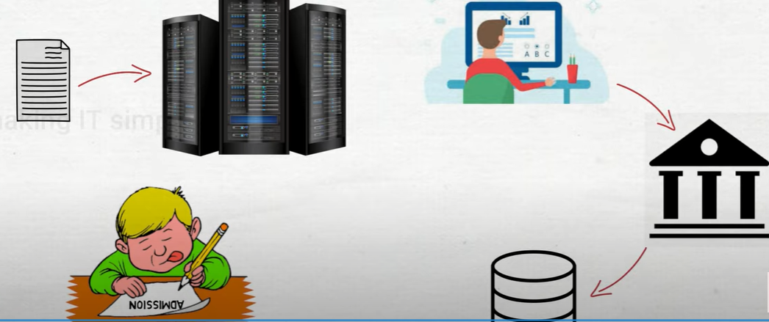
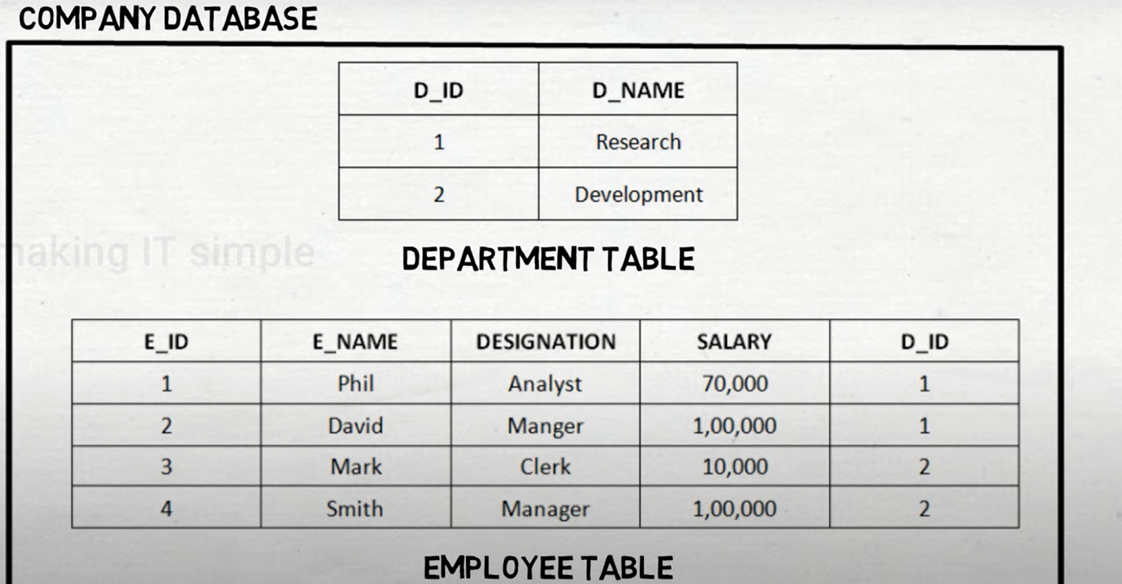



Database
1. Collection of Data
2. Stored electronically in a computer system
3. In a systematic Manner
$$1$$
$$2$$
$$3$$

Slide 5
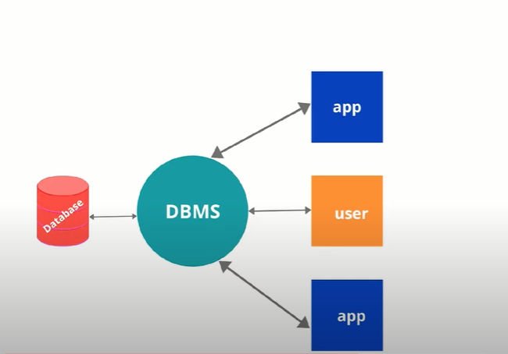
Is Database = DBMS?
Examples:
MySQL
PostgreSQL
Mongo DB

Slide 6
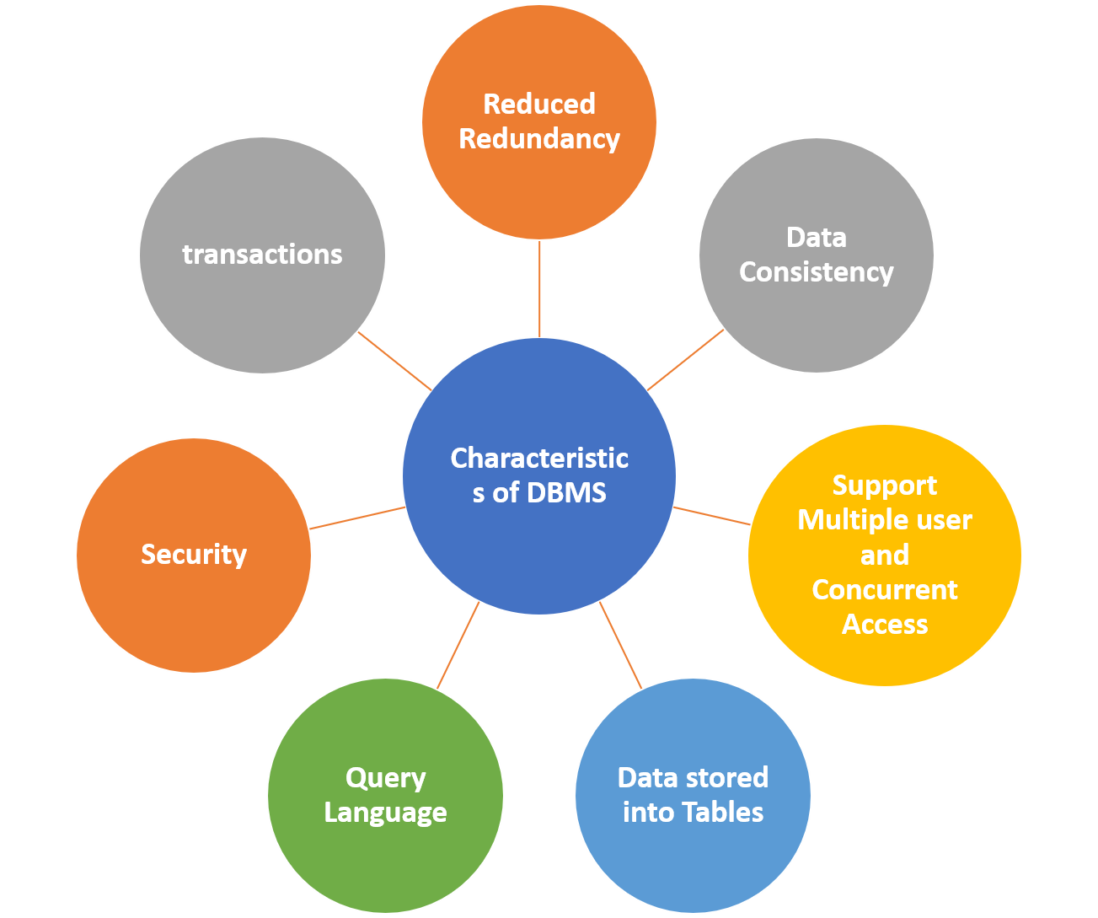
Characteristics

Slide 7
Languages
Data Definition Language-> Create, Alter, Truncate, Drop
Data Manipulation Language-> Insert, Update, Delete
Data Control Language-> Grant, Revoke
Transaction Control Language-> Commit, Save point, Rollback

Slide 8
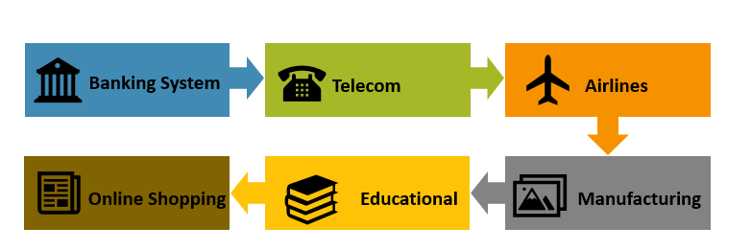
Applications

Slide 9
Thank you

